Slide 1


Slide 2


Slide 3


Slide 4


Slide 5
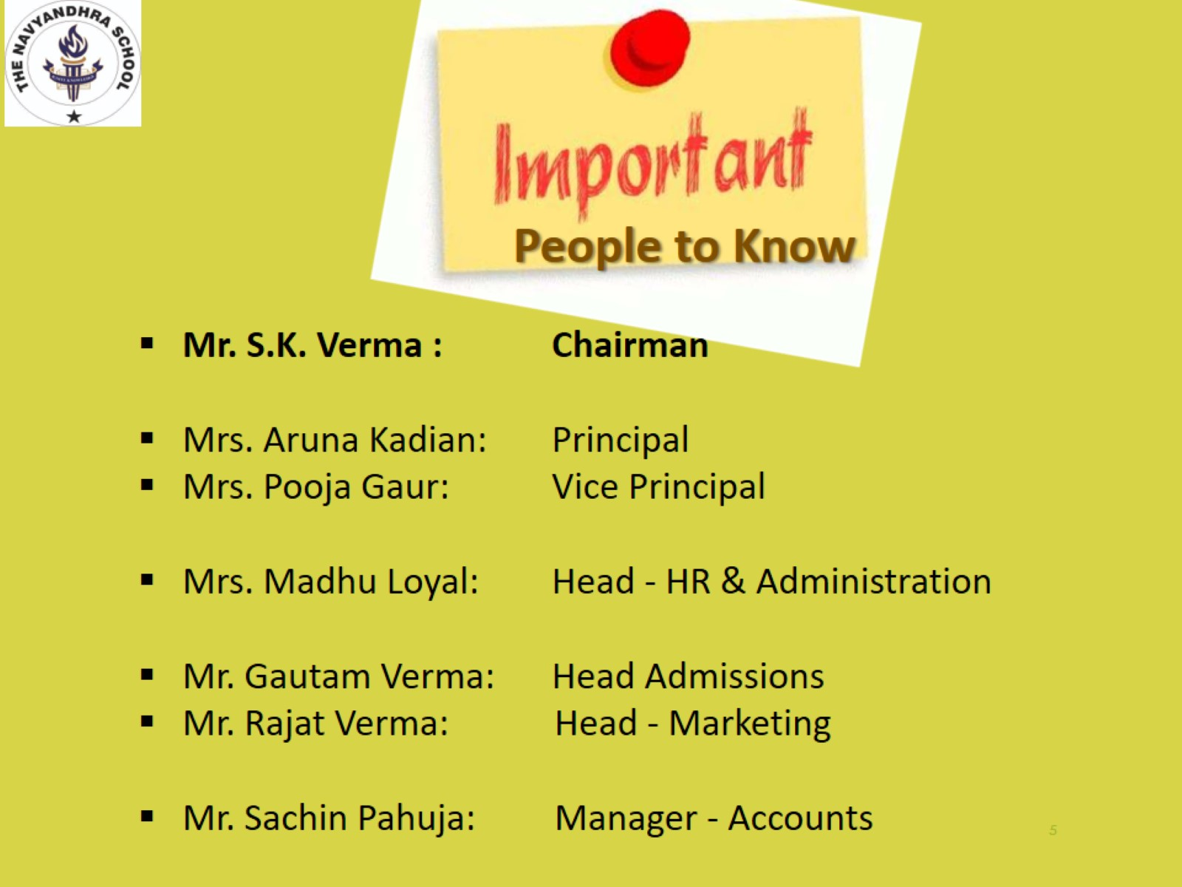

Slide 6
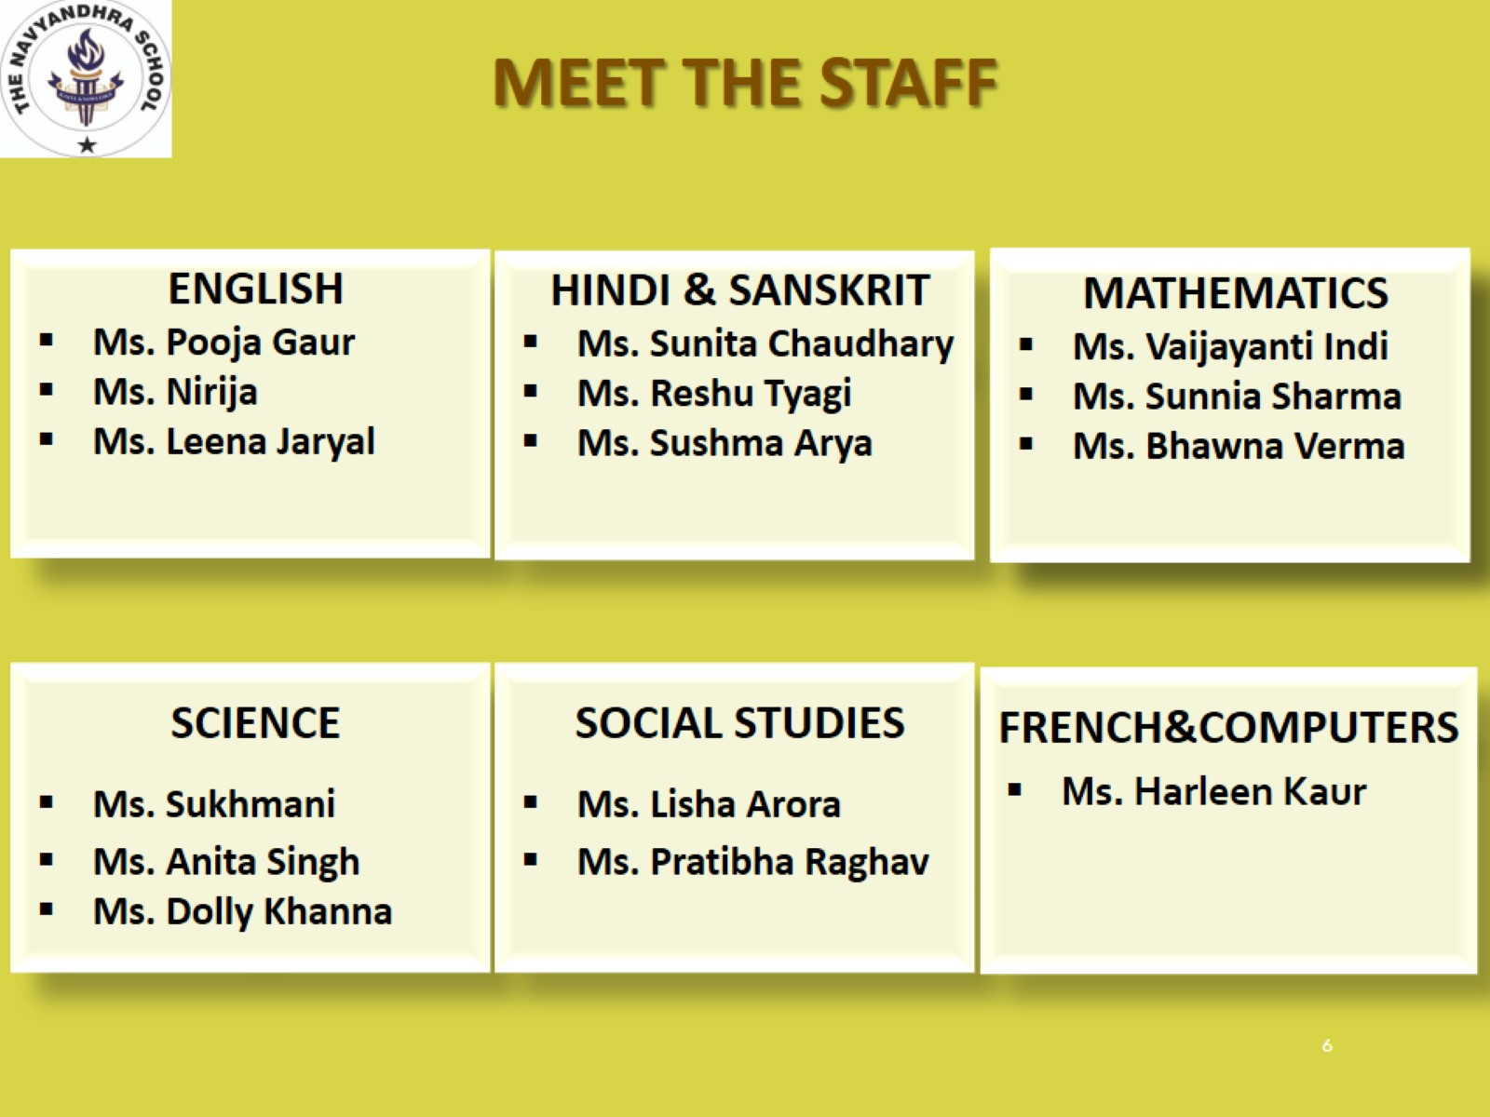

Slide 7
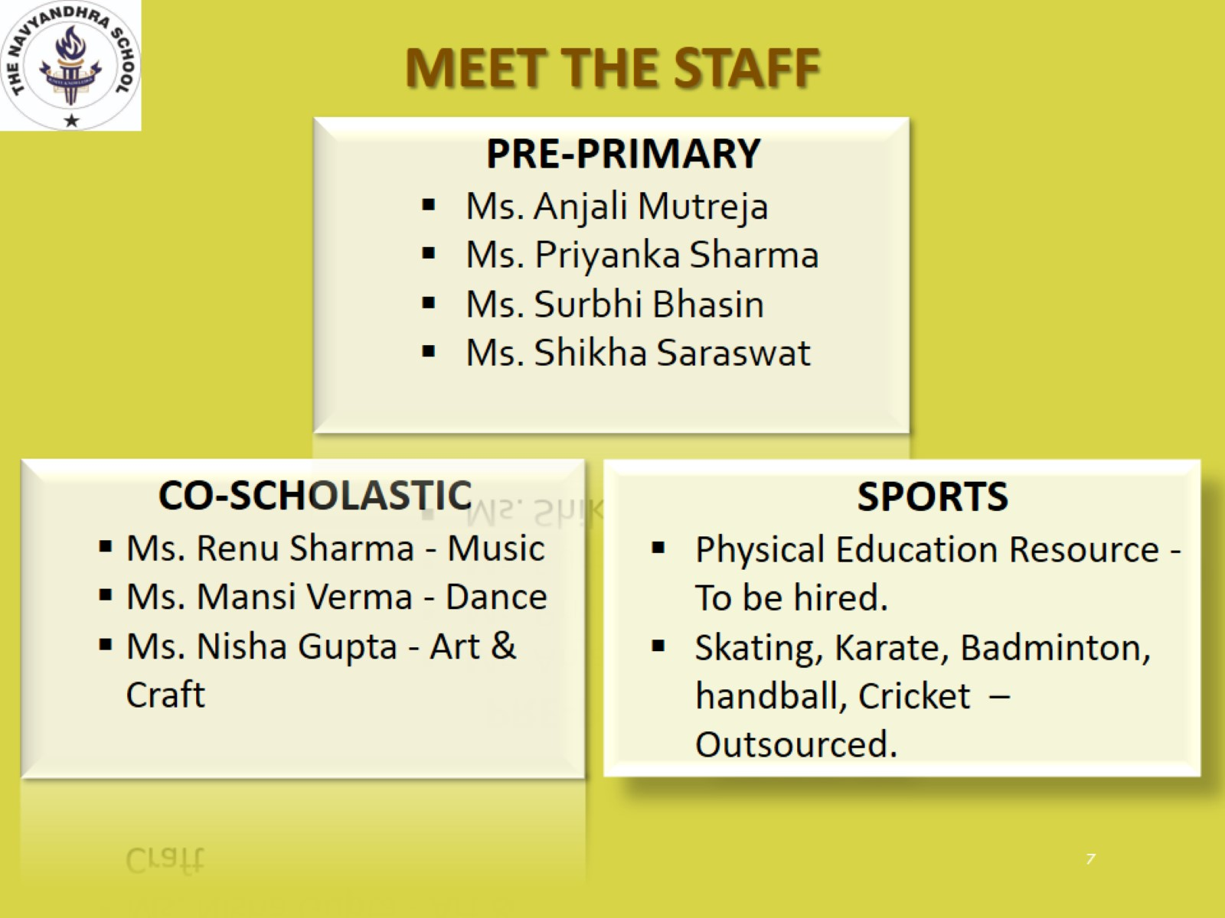

Slide 8

MEET THE STAFF
PRE-PRIMARY
Ms. Anjali Mutreja
Ms. Priyanka Sharma
Ms. Surbhi Bhasin
Ms. Shikha Saraswat
CO-SCHOLASTIC
Ms. Renu Sharma - Music
Ms. Mansi Verma - Dance
Ms. Nisha Gupta - Art & Craft
SPORTS
Mr. Moninder Singh.
Skating, Karate, Badminton, Handball, Cricket – Outsourced.

Slide 9
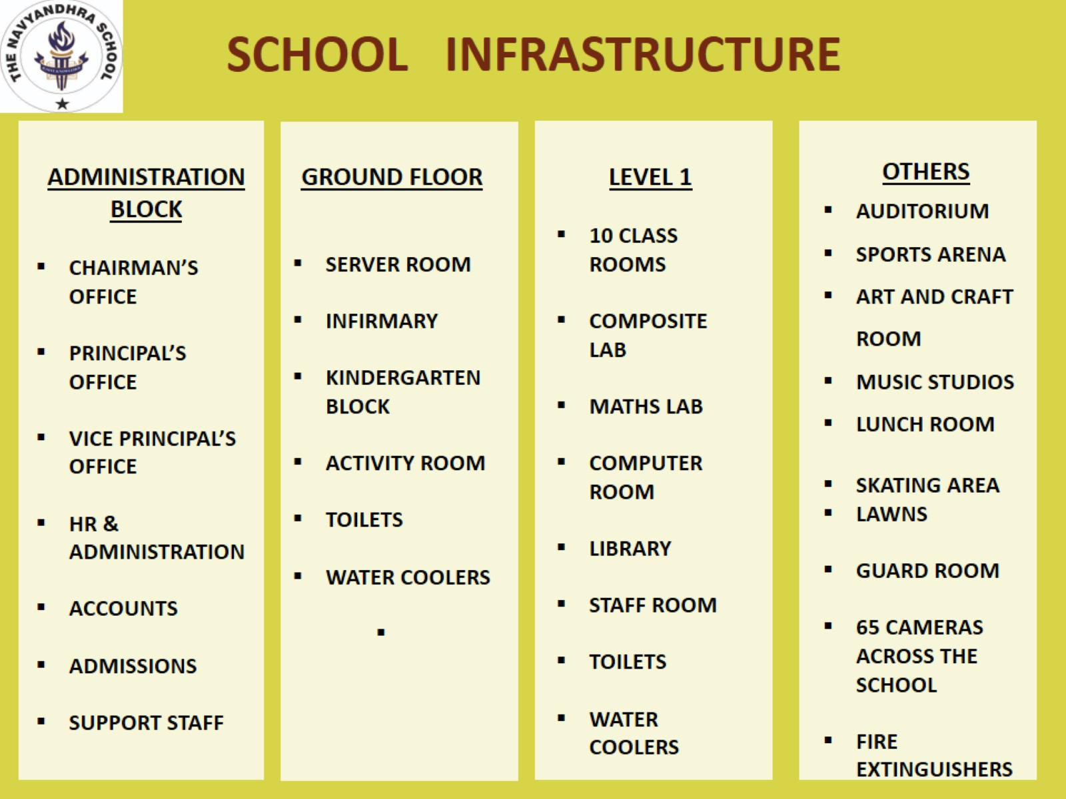

Slide 10


CORONA VIRUS PREVENTIONS

Slide 11
CORONA VIRUS
HOW IS THE SCHOOL PREPARED TO FIGHT THE SITUATION
Temperature check of all students after arriving at the school
Cleanliness and Hygiene a priority
Classes to be sanitised on daily basis
Sanitizer stands put across the school
Well Stocked Soap Dispensers in the washrooms
Masks arranged for all students
Academic and Non-Academic staff coached to carry out all
precautions and keep a strict watch on children for protection
Sick children will be sent back home
Teachers and support staff to wear masks
Students to sit individually on each desk – no sharing
Class rooms well ventilated and no air conditioning during
the Covid time.

Slide 12
CORONA VIRUS
CHECK-LIST FOR PRECAUTIONS AGAINST CORONA VIRUS
  Wash your hands frequently, always with soap and water for at least 20 seconds.: WELL STOCKED SOAP DISPENSERS IN THE SCHOOL WASHROOMS.
  Remember to not touch your face, eyes, nose and mouth: TEACHERS AND STAFF TO MONITOR THE STUDENTS AT ALL TIMES.
  Do not share cups, eating utensils, food or drinks with other.
  Be a leader in keeping yourself, your school, family and community healthy : REGUAR REMINDERS BY TEACHERS AT THE SCHOOL.
  Model good practices such as sneezing or coughing into your elbow and washing your hands.
  Tell your parents, another family member, or a caregiver if you feel sick, and ask to stay home.
  Parents to keep the school authorities informed if any family member gets impacted by Corona Virus.

Slide 13
SCHOOL SCHEDULE

Slide 14
STUDENT BELL SCHEDULE (I to X)
PERIOD | TIME
First | 09.00 – 09.45 am
Second | 09.30 – 10.30 am
Break | 10.30 – 11.00 am
Third | 11.00– 11.40 am
Fourth | 11.40 – 12.15pm
Fifth | 12.15– 12.55 pm
No After School Program till such time normal school is resumed

Slide 15

SCHOOL COMMUNICATION
Email: navyandhraschool@gmail.com
School Website : www.navyandhraschool.com
The Navyandhra School Facebook
SCHOOLEYE Navyandhra Web Portal
PTM’s and Phone calls
PTM’s for the year on: 31st July, 9th Oct, 4th Dec and 26th March
Special Meetings as and when required through the Class Teacher.

Slide 16
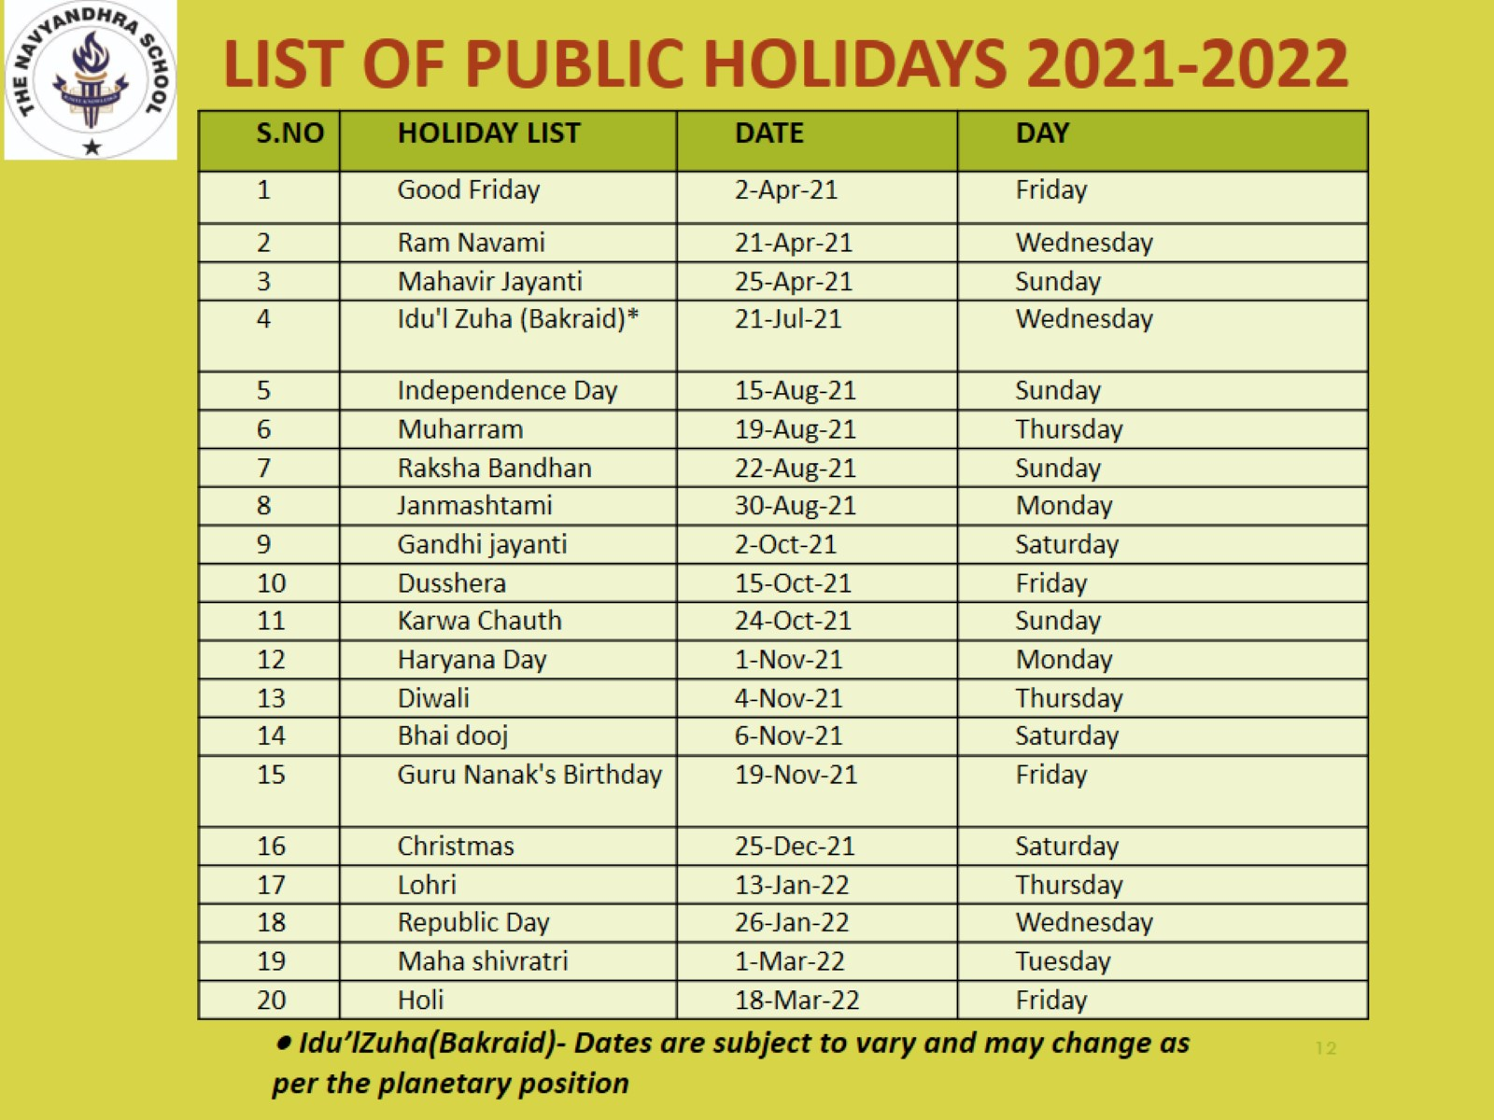

Slide 17
DETAILS OF SUMMER, AUTUMN & WINTER BREAKS
TYPE OF BREAK | FROM | TO | SCHOOL RE-OPENS
SUMMER | 22nd May | 30th June | Thursday, 1st July
DUSSHEHRA | 9th Oct | 17th Oct | Monday,18th Oct
DIWALI | 30th Oct | 07th Nov | Monday, 08th Nov
WINTER | 31st Dec | 09th Jan | Monday, 10th Jan
NUMBER OF WORKING DAYS : 227
1st & 3rd Saturdays working.
No ASP!
37
April - 20
May - 17
June - 0
2nd & 4th Saturdays OFF
70
July - 24
Aug - 22
Sep - 24
58
Oct - 17
Nov - 17
Dec - 24
62
Jan - 17
Feb - 22
Mar -23

Slide 18

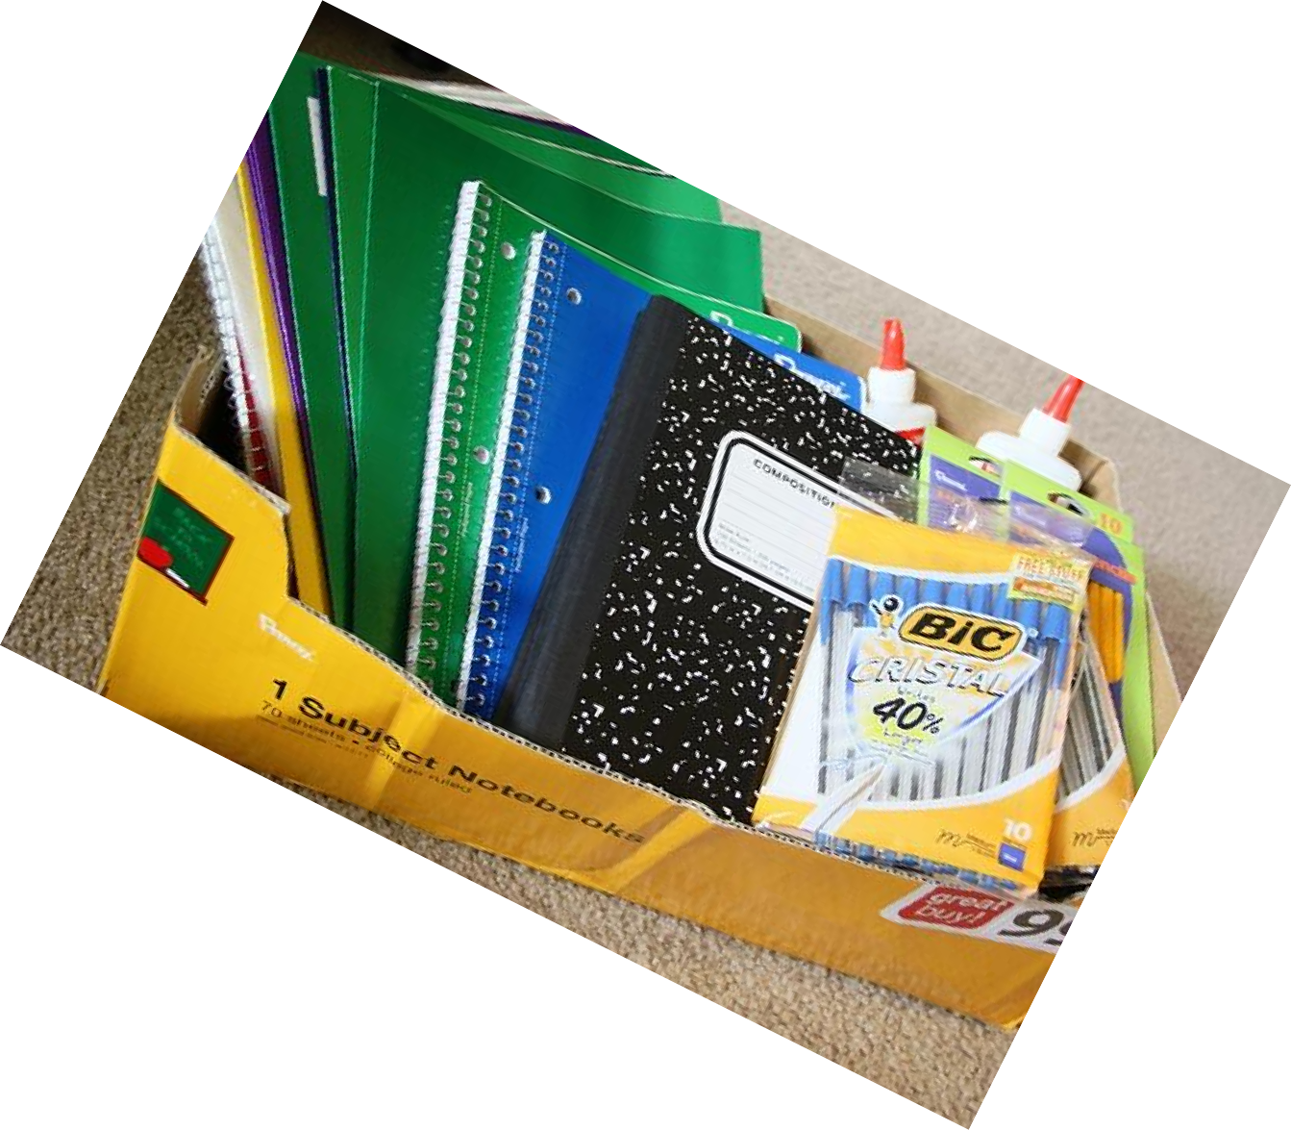
COURSE BOOKS FOR THE YEAR
For Grades 1 – 5:
ENGLISH: CAMBRIDGE
HINDI: MADHUBAN
MATHS : RATNASAGAR
EVS AND GK: OKFORD
COMPUTERS: KIPS PUBLICATIONS
Books should be purchased from the School’s authorized vendor.
For Grades 6 – 10
CBSE Syllabus and NCERT Books as well as various reference books for classes IX and X.
Students are encouraged to use the Library for Reference Books.

Slide 19
CO-SCHOLASTIC ACTIVITIES
SPELLATHON
OLYMPIAD
STORY TELLING
CUE MATHS
CODING
INTERSCHOOL COMPETITIONS
EDUCATIONAL WORKSHOPS
Notes:
OLYMPIAD – ONSITE PREPARATION – WITHOUT ANY ADDITIONAL CHARGE.
SUCCESSFUL PAST RESULTS WITH BRONZE, SILVER AND GOLD MEDALS WITH PARTICIPATION AT THE DISTRICT LEVEL.
CUE- MATHS – EXPLORING TO INTRODUCE IT IN THIS SESSION.
CODING – MANDATORY FOR ALL STUDENTS TO PARTICIPATE.
STORY TELLING – TO DEVELOP COMMUNICATION, CREATIVITY & IMAGINATION.
WORKSHOPS AND INTERSCHOOL COMPETITIONS – WITH OUR PARTNERS HOPE FOUNDATION AND TATA EDGE FROM TIME TO TIME.

Slide 20
SCHOOL ASSEMBLY
“Our School Assembly provides the opportunity for everyone at the School to consider spiritual and moral issues, to develop community spirit and reinforce positive attitudes” .
HELD FOUR TIMES IN A WEEK – VALUE AND THEME BASED
DURATION: 30 MINUTES
GROUND FOR SHARED PURPOSE, UNITY AND TEAM SPIRIT
FOCUSES ON ALL FORMS OF CURRICULAR AND CO-CURRICULAR ACTIVITIES
CELEBRATION OF FESTIVALS &
NATIONAL DAYS
INCULCATE SPIRIT OF PATRIOTISM
DEVELOPS CONFIDENCE
POSITIVE ATTITUDE, ETIQUETTS AND HABITS
GROUND FOR EQUAL OPPORTUNITY FOR EVERY CHILD TO DISPLAY ITS TALENT
FOSTERS LEADERSHIP SKILLS
IMPORTANT ANNOUCEMENTS
RECOGNITION AND AWARDS
BIRTHDAY CELEBRATIONS
PLATFORM FOR PRINCIPAL, VICE PRINCIPAL, GUESTS AND TO ADDRESS FROM TIME TO TIME

Slide 21
ROUTINE ASSEMBLY ACTIVITY
School Prayer, Pledge, National Anthem
Daily News, Pledge, Thought of the Day
Checking of Cleanliness and School Uniform and at times Mass Drill
Motivation by the School Principal
Birthday Celebrations and Show your Talent
Annoucements and Commendations

Slide 22
TRANSPORTATION
Bus Transportation:
Air conditioned buses equipped with cameras, connected to the console at School.
Nanny on each route.
Buses checked regularly by the Security Staff and Drivers coached periodically.
Rules for Students:
Students should be at the bus stop 10 minutes before arrival time.
No students are permitted to ride a bus not assigned to them with
out a bus pass. (obtained from the Administrative Office)
Students should not put their hand, head or body out of the window of the bus.
Bullying, fighting, use of bad language and indiscipline in the bus is prohibited.
Students should keep the bus clean, not make any noise and listen to the Teacher and Nanny escorting them.

Slide 23


Walkers / Bike Riders /
Cross roads only with supervision
Car Riders
Students to be dropped outside the main gate. Cars are not allowed to drive inside the school. Students upto KG to be handed over to the School Guard or Nannies.

Slide 24

MEALS
Two half breaks:
10.30 - Fruit, Snack, healthy drink.
1.30 pm - Lunch
1. Students are encouraged to:
sit and eat together
bring healthy tiffins and no junk food and no aerated drinks
2. Home Room/Class Teacher supervises the lunch time
and ensures proper lunch and sharing etiquetts.
3. Can bring their own lunch or buy from school whenever the
Meal Service begins.

Slide 25
SAFETY AND SECURITY
65 cameras across the campus.
Each and every area across the campus is continuously monitored.
Any bullying activity reported or seen at the campus is dealt with immediately.
Entry at the School Gate is restricted.
Parents are expected to cooperate with the School Security.
Students will not be handed over to the parents without the Pick-up cards.

Slide 26


SAFETY AND SECURITY
Medications:
Students are not allowed to bring or be in possession of any type of medication
All medication including prescriptions and over-the-counter medication should be delivered to the clinic by a parent or legal guardian in the original container(s) with proper labeling indicating names, dosage and time.

Slide 27
AFTER SCHOOL PROGRAM
The aim of the Program is to expand opportunities for robust student development through high-quality academic/tutorials, wellness and enrichment programs ‘After School’.
Program available from Monday-Thursday from 2-4 pm. Fridays are for Reading, Dramatics, Counselling, Preparation of Competitive Exams, School Club related activities etc.
Offers our students immense opportunities to explore and strengthen their talents in the creative sphere as well.

Slide 28

CLUBS AND PROGRAMS
School encourages the students to set aside a minimum of 30 minutes for reading and writing.
Interested students work with the Language Teachers on these activities to improve their reading and handwriting skills.
Repeated reading of the passages aloud can help correct their pronunciation and they can develop a flawless flow of reading.
We believe that the more the child reads, the more interesting the life becomes.
Clubs and Programs
Art
Books, Reading Writing & Debates
Choir Group
Maths
Science
Heritage

Slide 29
RELATED ART
Related Art
General Music
Dance: Kathak, Jazz, Hip Hop
Art & Craft
Instruments Key board & Harmonium
.

Slide 30
SPORTS
SPORTS
Karate
Handball and Basket Ball
Badminton
Cricket
Skating
Table Tennis

Slide 31
DISASTER MANAGEMENT
Corridors well marked with exit points.
Awareness programmes are organised for the students and staff.
Mock drills like Fire drill, Earthquake drill are performed regularly.
The school is equipped with Firefighting system and is tested on regular basis.

Slide 32
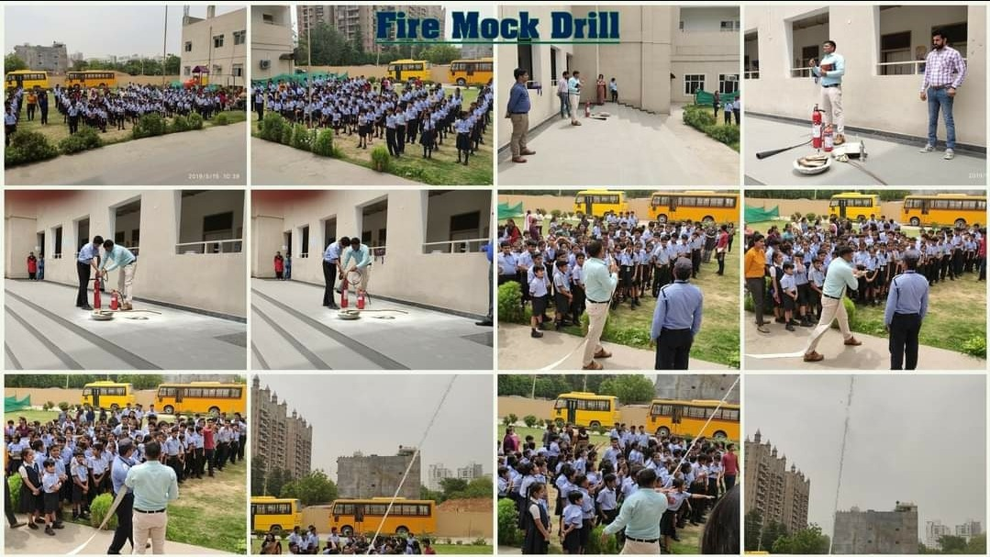
DISASTER MANAGEMENT

Slide 33
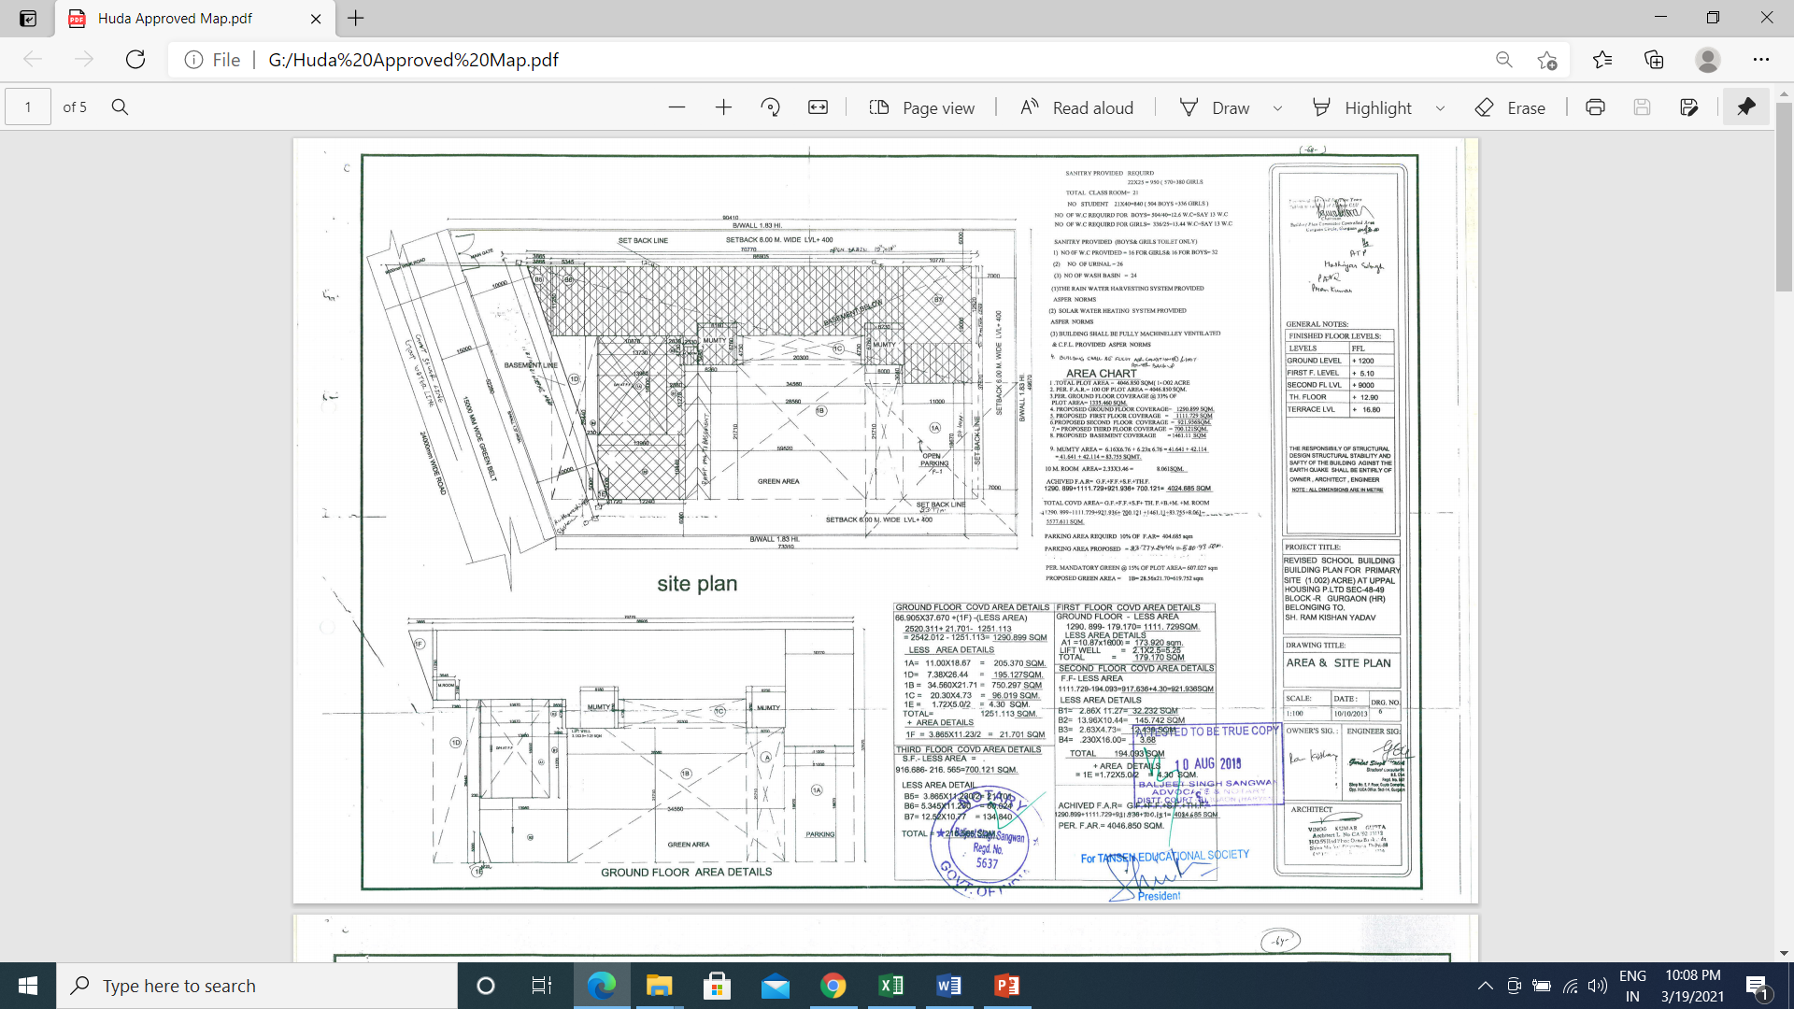
SCHOOL MAP

Slide 34
EVENT CALENDAR - 2021
CLASSES 1-5
Month | Activities
April | Earth Day Celebration-Kabad Se Juggad Kabaddi Inter House Competition English Quiz Inter House Competition World Health Day focusing Healthy Lunch Spellathon
May | Mother’s day celebration-Photo Frame and Card Making Competitions Spellathon
July | English Handwriting Inter House Competition Table Tennis Inter House Competition Spellathon
August | Book Week (2nd August-7th August) Independence Day Celebration-Inter House Competition Spellathon
September | Hindi Doha Vachan Competition Teacher’s Day Celebrations No Bag Day

Slide 35
EVENT CALENDAR - 2021
CLASSES 1-5
Month | Actiivity
October | Non-Fire Competition Basketball Competition Talk on National Leaders - Gandhi ji/ Lal Bahadur Shastri Diwali Fair
November | Children’s Day/ Movie DAy Spellathon Special Assembly on Diwali Badminton Inter House Competition
December | Christmas Celebrations Maths Quiz Inter house Competition Spellathon
January | Republic Day Celebrations Group Song Competition Girl Child Day(23 Jan) Spellathon
February | Hindi Recitation Competition G.K Quiz Competition

Slide 36
EVENT CALENDAR - 2021
CLASSES 6 - 10
Month | Activities
April | Earth Day Celebration-Kabad Se Juggad Kabaddi Inter House Competition English Quiz Competition-Inter House Competition World Health Day (Healthy Lunch) Spellathon
May | Mother’s Day Celebration- Creative Writing Competition and Card Making Competition Spellathon
July | English Handwriting Competition-Inter House Table Tennis Inter house Competition INVESTITURE CEREMONY Spellathon
August | Book Week (2nd August-7th August) Independence Day Celebrations- Folk Dance Inter House Competition) Quiz on Incredible India-Inter House Competition Spellathon

Slide 37

VALUE EDUCATION
To Never Give Up, Reflective, and Self Engaged.
Character Building
Traits like Loyalty, Honesty, Truthfulness, Courage, Responsibility Respect, Discipline, Compassion, Bravery inculcated through the lives of Leaders, Story Telling, live examples, motivational talks etc.
Positive Attitude
Personality Development
  Train students to be Confident, Set Clear Goals, Be Happy, Acceptable, Not to be Complacent, Find Solutions, Be Aware of Diversity and Gender, Know they are Unique, Team Spirit, Have a High Self Esteem and remain grounded and Helpful.
We at The Navyandhra aim to help students become active & responsible
world citizens with Traditional Values and Modern Thinking.

Slide 38

STOP THE SPREAD OF CORONA VIRUS

Slide 39
KNOW OUR
PRE-PRIMARY

Slide 40
STUDENT BELL SCHEDULE: PRE-PRIMARY
Agenda | Time
Circle time | 08.30 – 09.00 am
Assembly (Pre Primary) | 09.00 – 09.15 am
Fruit Break | 09.15 – 09.35 am
Written work 2 | 09.35 – 11.00 am
Break and Play Time | 11.00 – 11.40 am
Life skill, E.V.S ,Rhymes and Reinforcement | 11.40 – 12.30 pm
Homework Assistance | 12.30 – 01.30 pm
Lunch | 01.30 – 02.00 pm
After School Program* | 02.00 – 04.00 pm
Naptime for pre-nursery. Flexible timings of time table Time table will be shared with you

Slide 41
PEDAGOGICAL APPROACH
Child Centric Learning
Enquiry Based Learning
21st Century Skills
Technology Integration
Multiple Intelligence
Experiential Learning

Slide 42


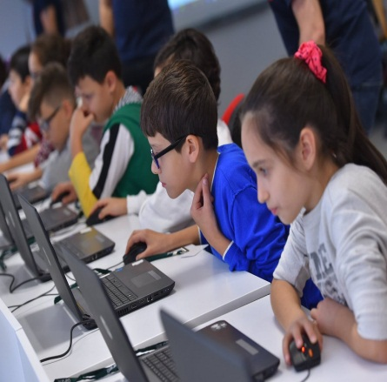
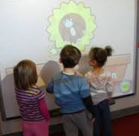
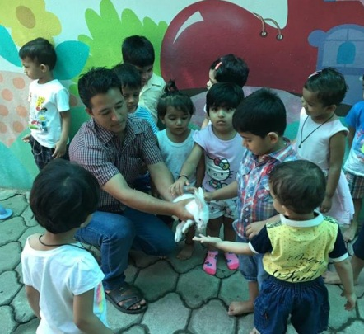
CHILD CENTRIC LEARNING
We operate with a Child Centred Philosophy,
Individualized Learning is the key factor.

Slide 43
ENQUIRY BASED LEARNING
How we Educate
The Image of the Child
Emergent Curriculum
Project Work
Role of the Teacher
The Role of Environ-ment
Parental Involvement
Document-ation

Slide 44
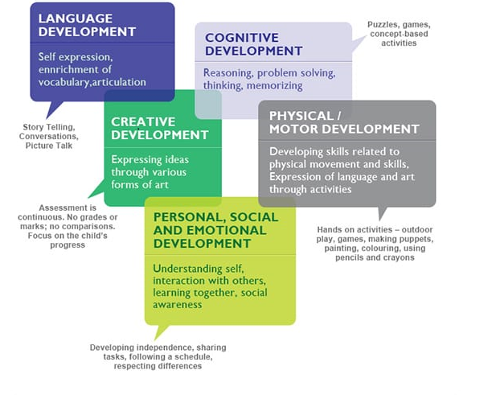
CURRICULUM APPROACH

Slide 45
ASSESSMENT PATTERN
PRE-PRIMARY

Slide 46
ASSESSMENT KEYS: PRE-PRIMARY
Physical and Motor Development
Gross motor skills
Fine motor skills
Eye – hand coordination
Participation in indoor and outdoor activities
Socio-Emotional Development
Interaction with peer group
Interaction with teachers
Willingness to share
Follows simple instruction
Personality Traits
Personal hygiene
Courtesy and Politeness
Taking Initiative
Responsibility
Ability to identify more/less

Slide 47
ASSESSMENT KEYS: PRE-PRIMARY
Numbers
Ability to identify and quantify number
Writing of numbers
Ability to put numbers in order
Ability to do grouping of objects
Cognitive Development
Listening and speaking
Reading and Writing
Numeracy Skills
Co-scholastic Development
Dance
Music
Sports

Slide 48

PROTECT YOURSELF FROM CORONA VIRUS
MAINTAIN HYGIENE

Slide 49
ASSESSMENT PATTERN
GRADES I – X
Facilitator: Ms.Bhawna Verma

Slide 50
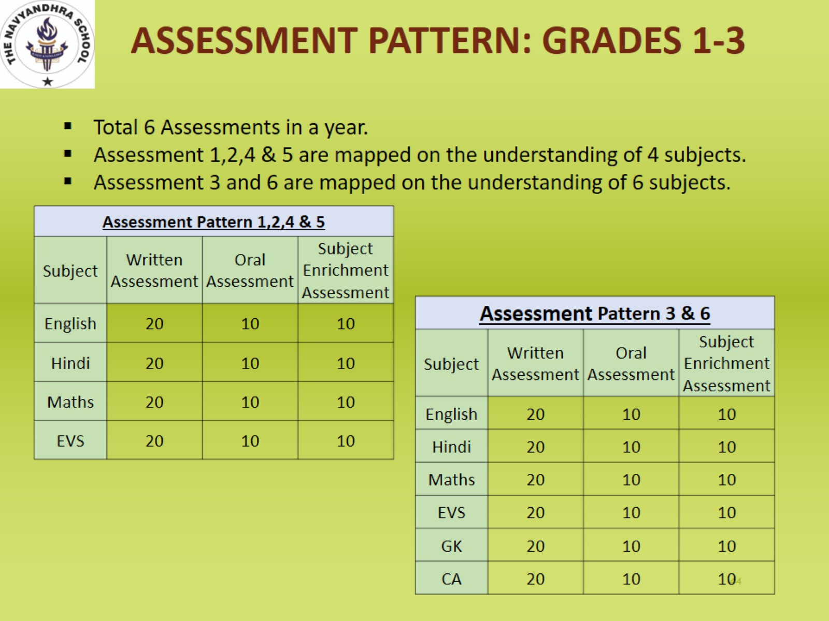

Slide 51
ASSESSMENT PATTERN GRADES 4-5
Total 4 Assessments in a year.
Pre-Mid and Post-Mid Assessments are mapped on the understanding of 6 subjects.
Mid-Term and Annual Exam are mapped on the understanding of 8 subjects.
Pre-Mid & Post Mid Test
Subject | Written Assessment
English | 40
Hindi | 40
Maths | 40
Science | 40
French/Sanskrit | 40
SST | 40
Mid-Term and Annual Exam Assessments
Subject | Theory | Subject Enrichment | Notebook
English | 60 | 10 | 10
Hindi | 60 | 10 | 10
Maths | 60 | 10 | 10
Science | 60 | 10 | 10
SST | 60 | 10 | 10
French/Sanskrit | 40 | 5 | 5
GK | 40 | 5 | 5
Computer Applications | 25 | Practical 25

Slide 52
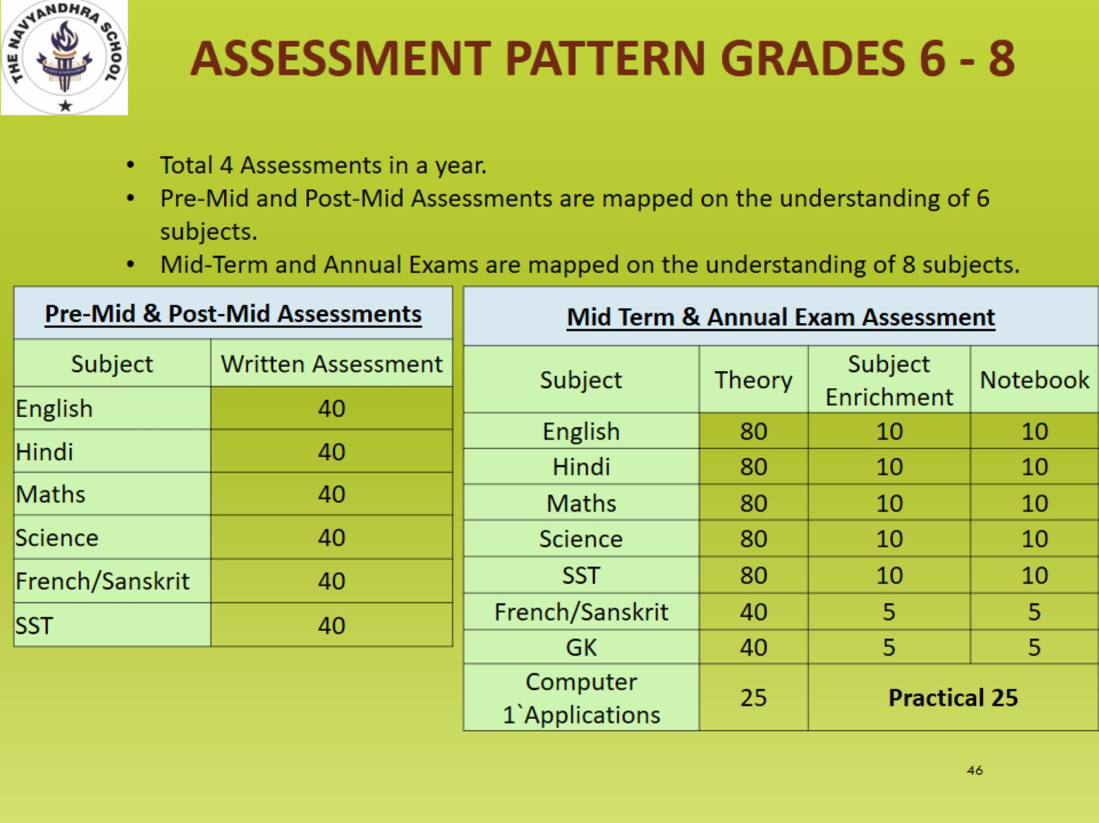

Slide 53
ASSESSMENT PATTERN GRADES 9 - 10
Total 4 Assessments in a year.
Pre-Mid and Post-Mid Assessments are mapped on the understanding of 6 subjects.
Mid-Term and Annual Exams are mapped on the understanding of 8 subjects.
Pre-Mid & Post-Mid Assessments
Subject | Written Assessment
English | 40
Hindi | 40
Maths | 40
Science | 40
French/Sanskrit | 40
SST | 40
Mid Term & Annual Exam Assessment
Subject | Theory | Subject Enrichment | Notebook
English | 80 | 10 | 10
Hindi | 80 | 10 | 10
Maths | 80 | 10 | 10
Science | 80 | 10 | 10
SST | 80 | 10 | 10
French/Sanskrit | 40 | 5 | 5
GK | 40 | 5 | 5
Computer Applications | 40 | Practical 10
Note : For 9th and 10th French/Sanskrit and IT will be out of full marks i.e. 80 and 20.

Slide 54
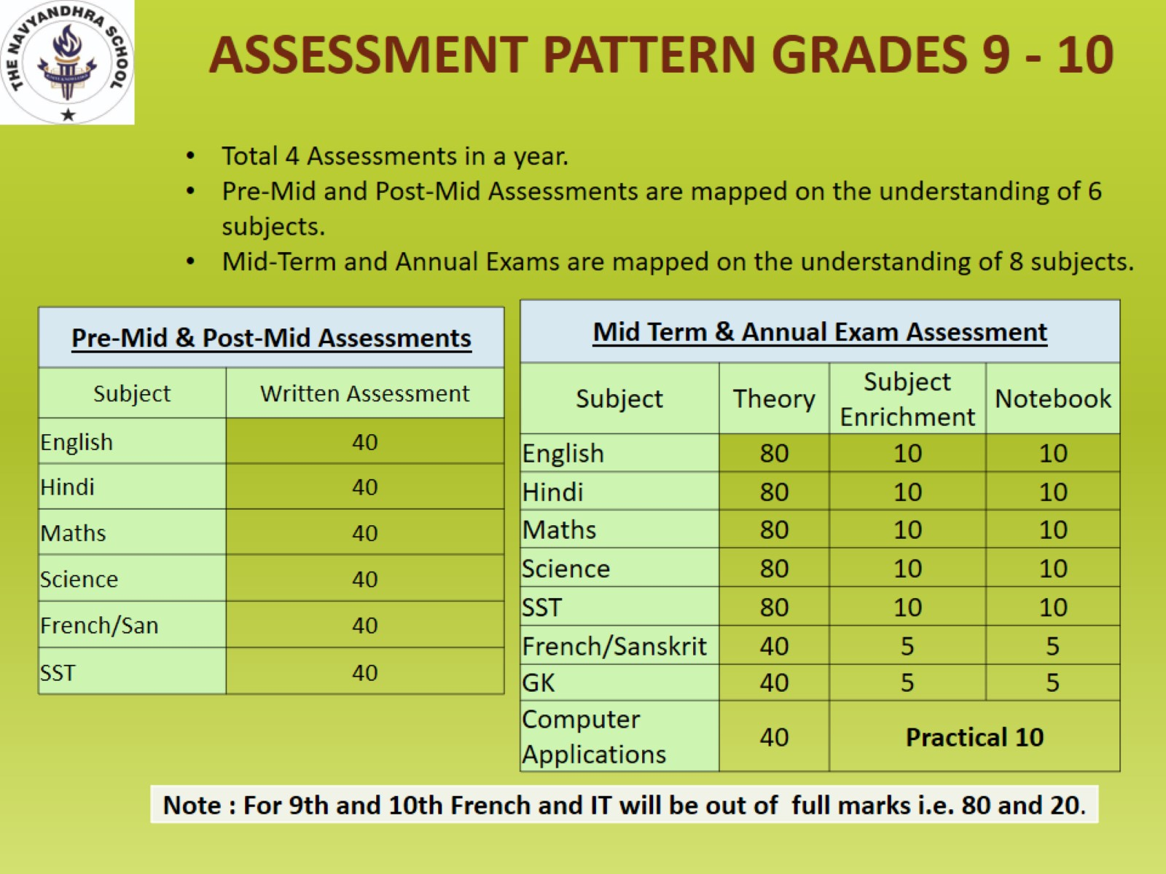

Slide 55
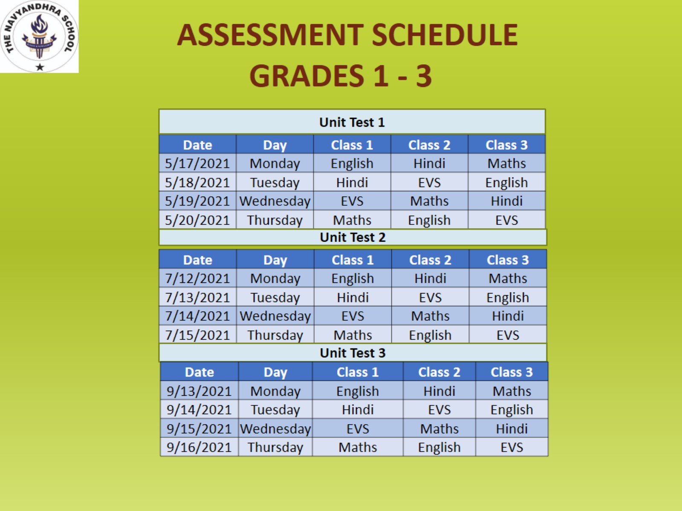

Slide 56
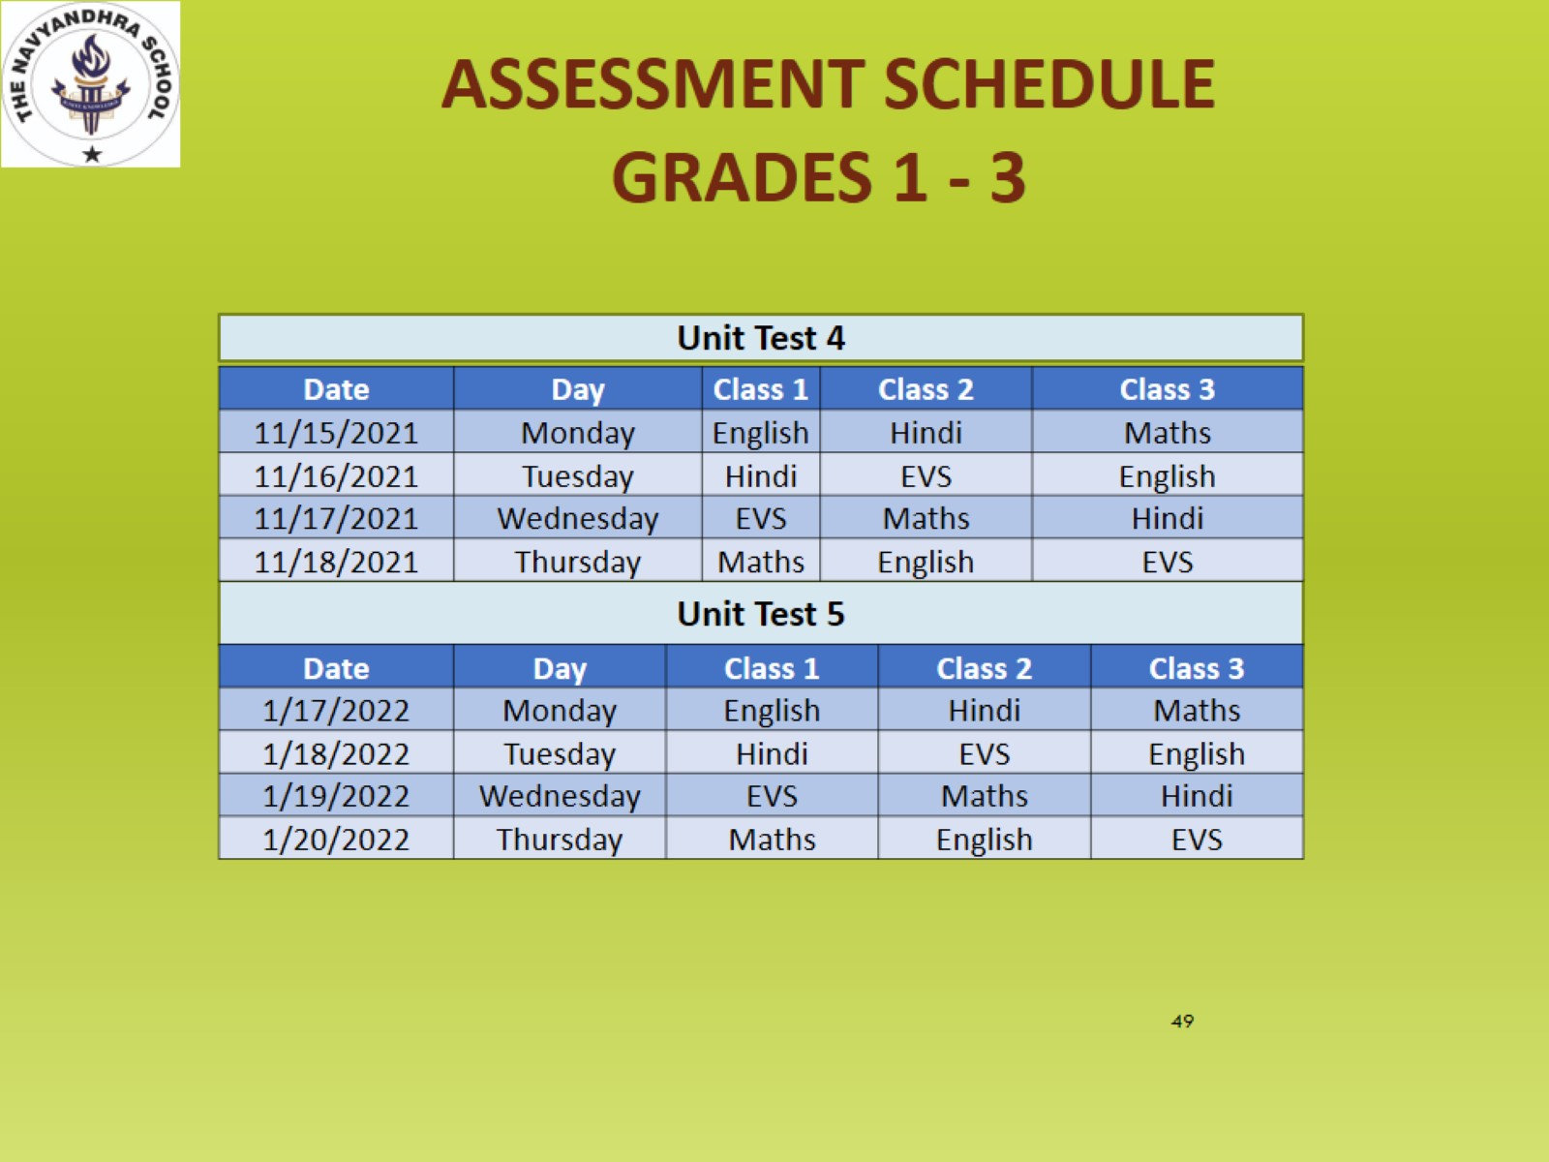

Slide 57
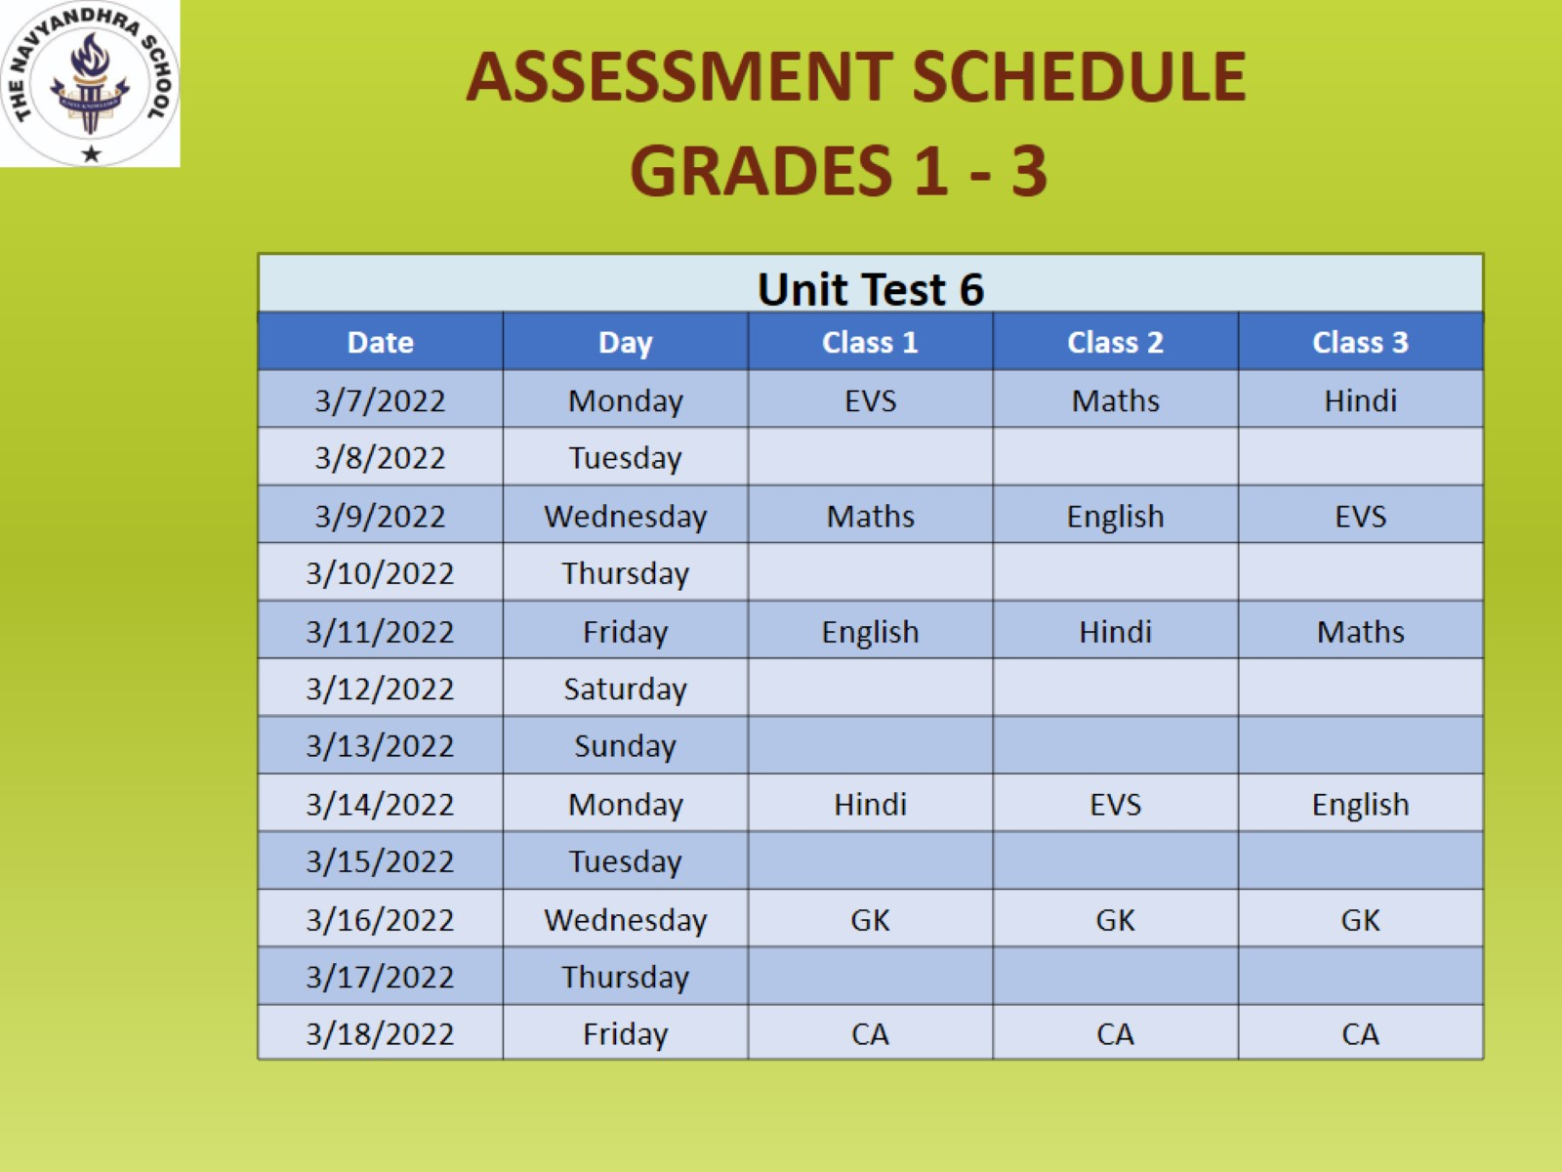

Slide 58
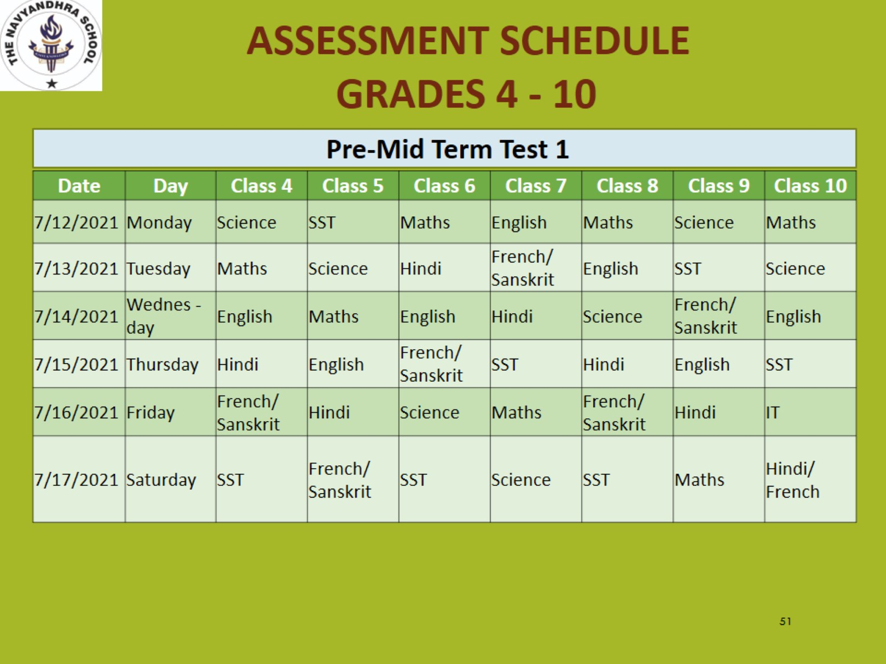

Slide 59
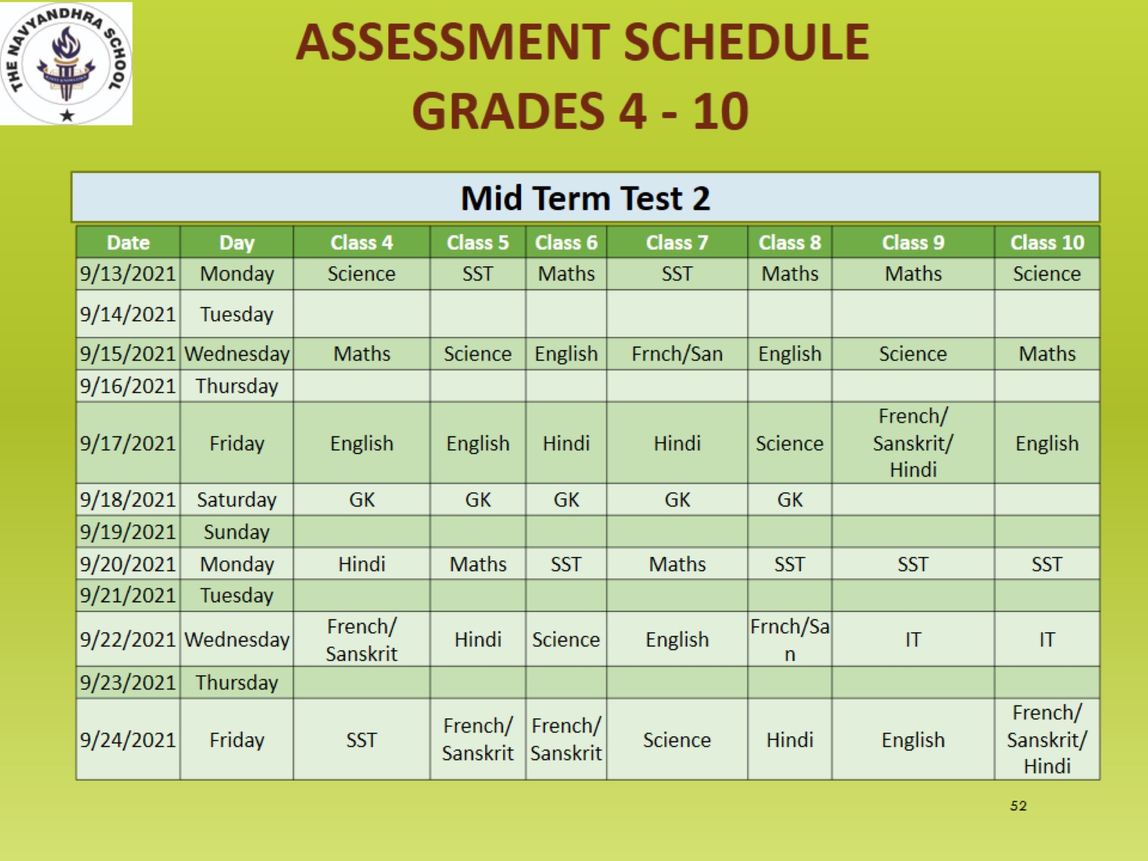

Slide 60
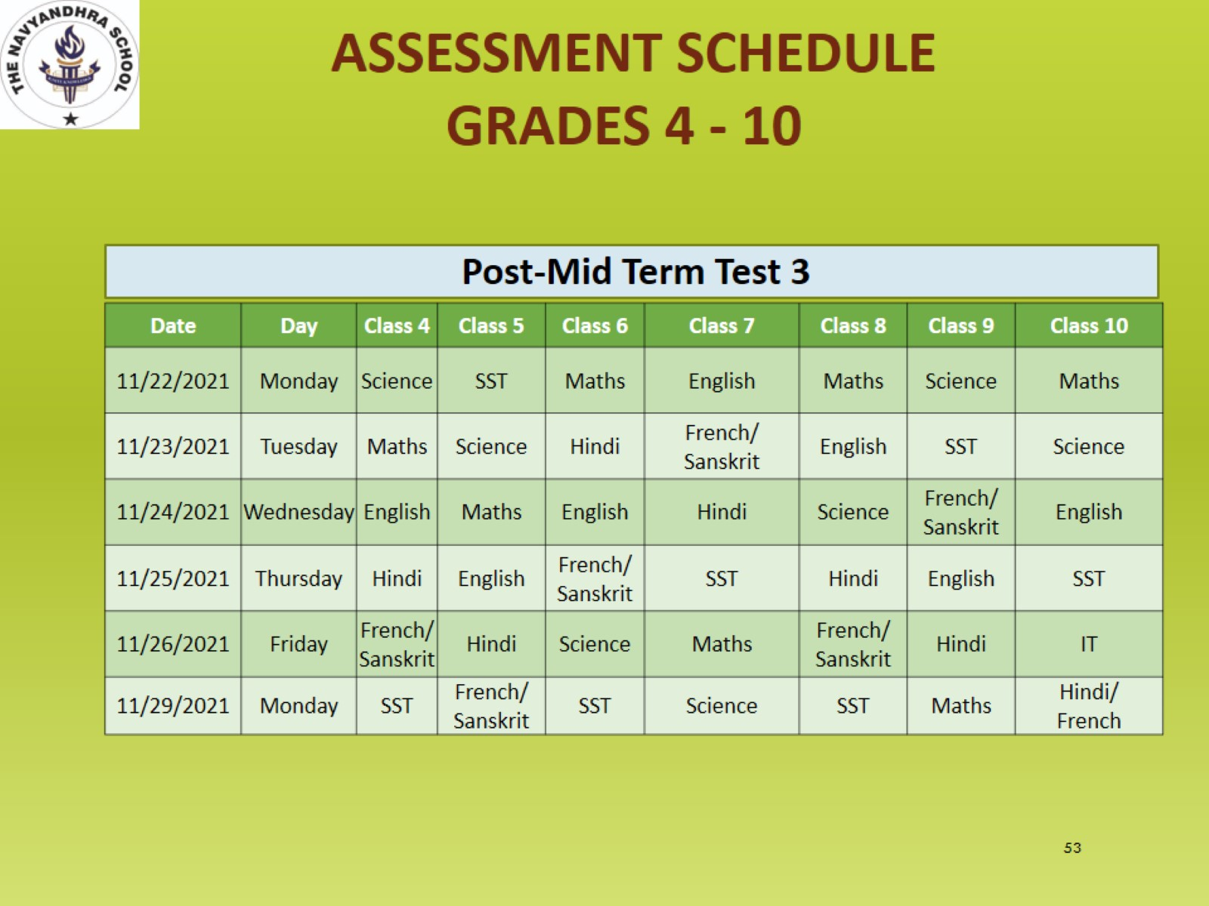

Slide 61
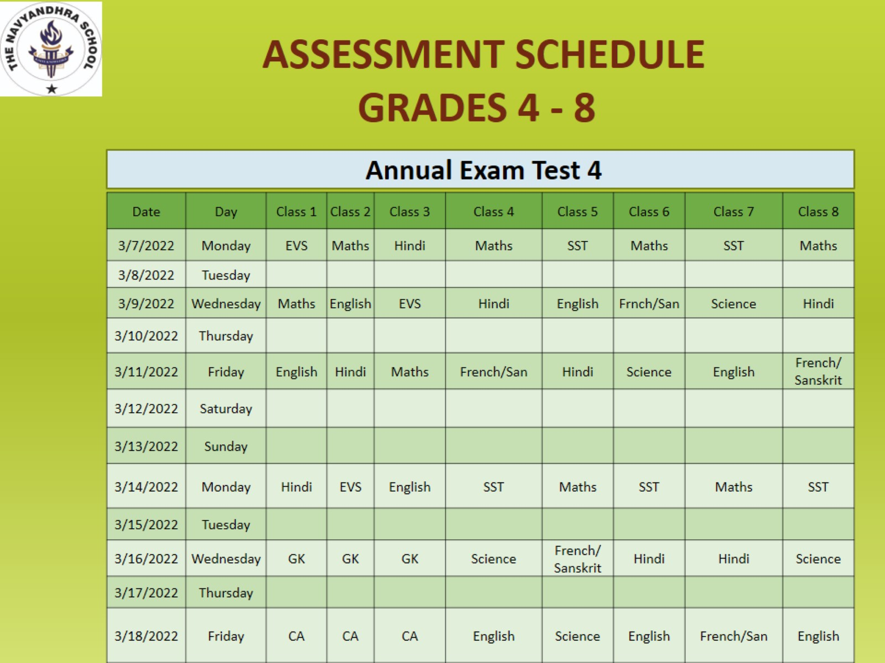

Slide 62
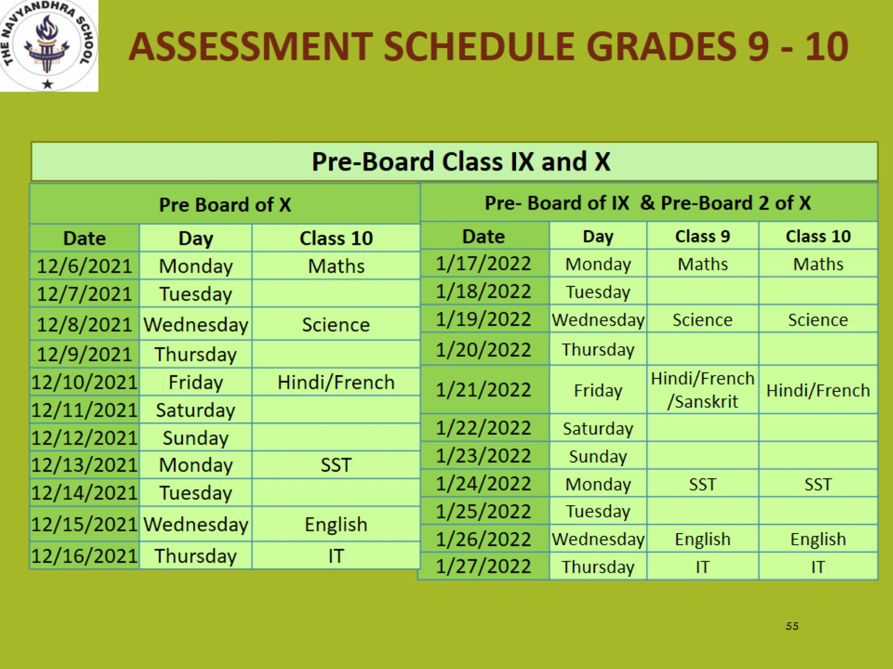

Slide 63
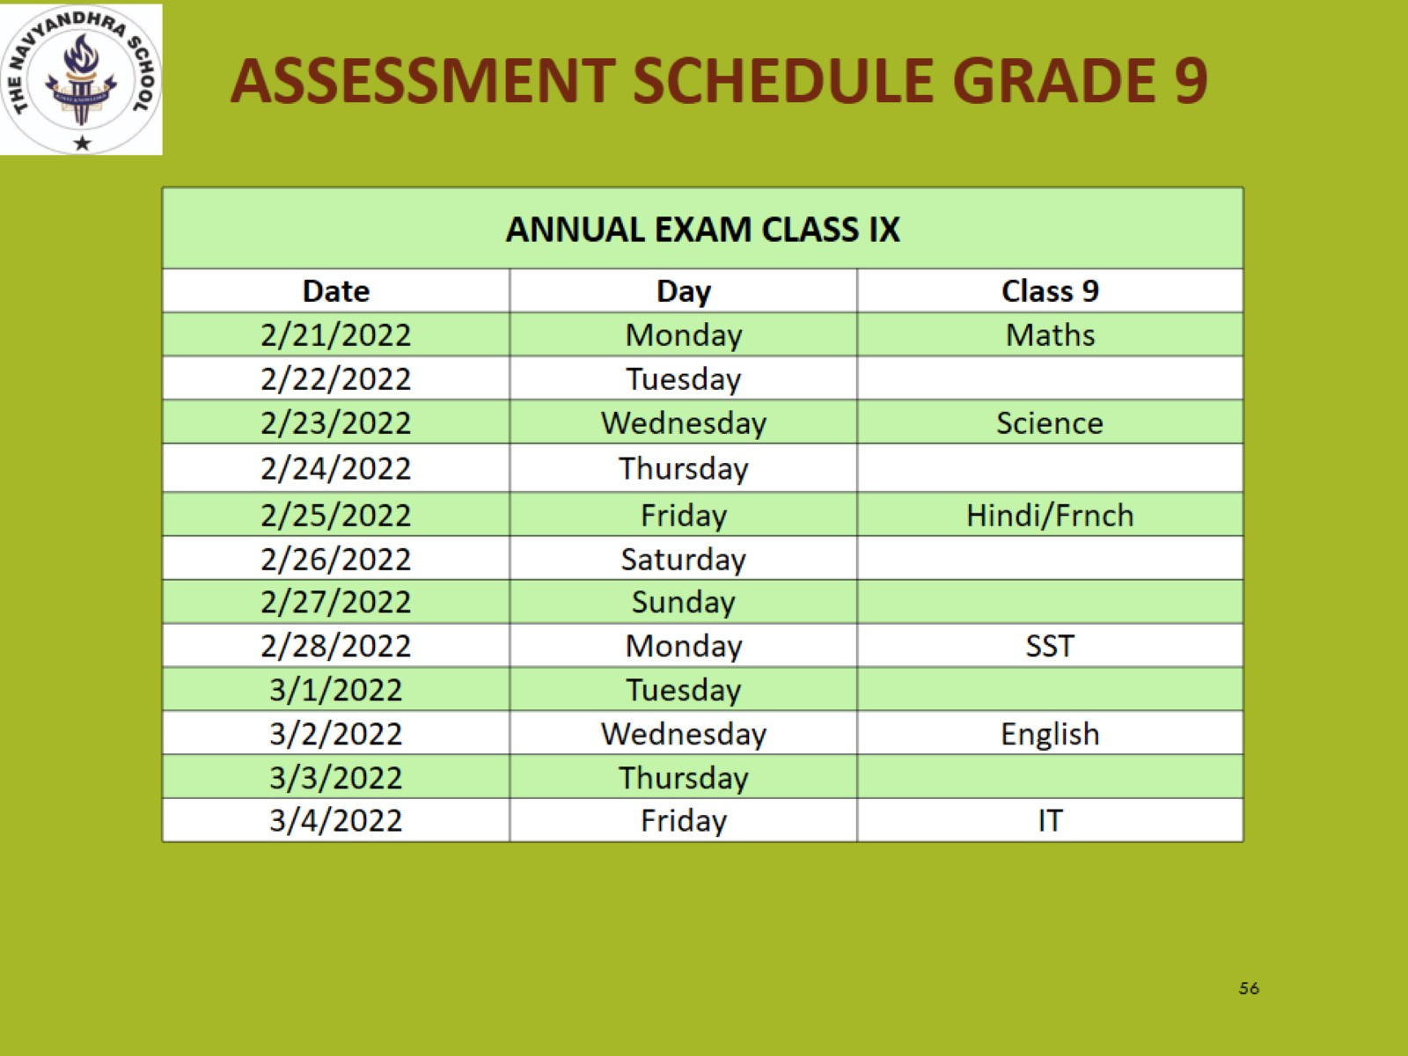

Slide 64
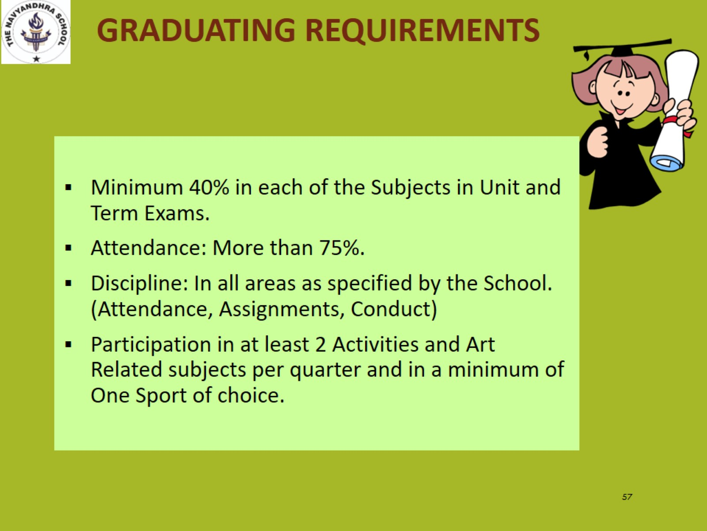

Slide 65
DISCIPLINE
AT
NAVYANDHRA
FACILITATOR: MADHU LOYAL

Slide 66

PARENTAL SUPPORT
With your help,
Your child can create
A solid plan that will guide
him or her towards a successful
and rewarding career.

Slide 67
HOW TO ASSIST YOUR CHILD
Parent Involvement - #1 Indicator for Student Success
Encourage communication about topics learned in school.
Stay current on school news.
Check grades often.
Encourage after school routine for homework and organize
Oversee organization but have student ultimately responsible.
Reinforce school expectations
Don’t rescue them from consequences.
Help student social skills.
Encourage student to be involved - clubs or other extracurricular activities
Talk about positive behavioral traits (good friend, drama-free, listening, etc.)
Practice communication skills
Discuss various social interactions
Encourage Attendance and Good Work Habits

Slide 68
DISCIPLINE
PROPER UNIFORM, SCHOOL SHOES, TIE AND BELT.
WEARING MASK IS A MUST AND TO CARRY SANITIZER.
MUST WEAR SCHOOL IDENTITY CARD.
WELL GROOMED HAIR AND NO FANCY HAIR STYLE.
PROPER ORA HYGIENE, WELL MANICURED NAILS.
NO EXPENSIVE STUFF OR ACCESSORIES ALLOWED. ONLY SIMPLE WRIST WATCH FROM CLASS V ONWARDS.

Slide 69
DISCIPLINE
STUDENTS SHOULD NOT BE CARRYING MOBILE PHONES OR ANY SHARP THINGS LIKE SCISSORS, BLADE ETC.
ALL SPORT BELONGINGS AND IMPORTANT ITEMS SHOULD BE PROPERLY LABELLED..
STUDENTS MUST REACH SCHOOL BY 8.25 AM AS THE SCHOOL GATE WILL CLOSE SHARP AT 8.30 AM.
SHOULD NOT TAKE LEAVE ON SMALL PRETEXTS.
LEAVE APPLICATION OR INTIMATION IN WRITING MUST BE SENT BY THE PARENTS TO SCHOOL.
PARENTS MUST ENSURE TO SEND BOOKS TO SCHOOL AS PER THE TIME TABLE OR MAKE THE CHILD RESPONSIBLE.

Slide 70
DISCIPLINE
Appropriate Length: Approach the top of the knee, minimum fingertip length
No headbands coverings worn indoors
No inappropriate slogans or pictures (i.e. tobacco, alcohol, drugs, racial remarks, gang affiliations, or sexual connotations)
Proper uniform to ensure that undergarments do not show up.
No low cut necklines, off-the-shoulder shirts, pajamas, or slippers on Birthdays or if not wearing uniform due to some reason.
Pants or skirts with cuts or holes require an additional layer underneath to prevent skin visibility.

Slide 71

ARRIVING LATE AT SCHOOL
Students arriving after 8.25 am are considered late to school.
Students must report to the Administrative Office to obtain a pass to the class.
Students receive warning after 5 late arrivals either to the class of the zoom sessions Or to the School.
Help your student develop a system to ensure they are ready to leave for
school in plenty of time so they do not miss out on valuable instructional time.
Students need to serve Detention after 5 warnings.

Slide 72
ATTENDANCE/ABSENCES
Any student absent from school is required to bring a written explanation signed by the parent/legal guardian to the Administration Office.
Students have up to 5 days to provide written documentation for the absence to be excused.
Students must attend 75% of the class period to be considered present.
After a total of 9 absences (excused or unexcused) in any class period per semester, the student must have a note from a doctor or official agency in order for each subsequent absence to be excused.
After the 15th absence (excused or unexcused) in any class period per semester, make- up work will not be allowed.
attendance is KEY to academic success in middle & senior school!

Slide 73

CELL PHONES
Per School Management Board Policy, any student in possession of a wireless communication device while on school property must ensure the device is not visible/deposited with the Class Teacher on arrival and is turned off during school hours. Students may use their cell phones after dismissal to contact parents.

Slide 74


BULLYING
Bullying is defined as a serious offence at The Navyandhra Campus
Bullying may involve but is not limited to: repeated teasing, social exclusion, threats, intimidation, stalking, physical violence, sexual, religious, or racial harassment, or public humiliation.
A student who feels he or she is the victim of bullying / threats OR witnesses actions viewed as bullying should report it to the school administration or resource officer immediately

Slide 75

CAMPUS VISITATION AND STUDENT CHECK-OUT
Visitors: All parents and/or visitors on campus must sign in with a picture ID and obtain a visitor’s badge from the Attendance Office.
The visitor badge must be worn the entire time the visitor is on campus.
Student Check Out: Only individuals indicated on a student’s blue emergency card will be permitted to pick up a student from school. Individuals checking out a student must have a picture ID.

Slide 76

THE NAVYANDHRA WAY
Schoolwide Expectations for Students Conduct
Be Respectful
Follow Instructions
Speak and Walk Appropriately
Be On Time
Be an Engaged Learner
Repeat Offenses
After School Detention
All Saturday working
Out-of-School Suspension (OSS)
Suspension from Extra-Curricular Activities and/or Field Trips
Students + Parents + Teachers + Administration = The Navyandhra Team

Slide 77

WE are looking forward to a successful 2021-2022 school year and help your child gain both academic and social skills that will be vital to their future.
Please let us know how else we can help your child have the best possible experience.

Slide 78
THANK YOU

Slide 79
QUESTIONS?

